Slide 1

Sprint Retrospective SIT 223
By Group 5
Notes:
Hello, my name is Jack and I am here to deliver our group presentation of Retrospective task, we are all members of Group 5. The rest of our group consists of Harshit, Rina, Tushar, and the recently added Dinul.

Slide 2
Group Members
Name | Student ID | Grade
Harshit Saxena | 218699327 | HD
Jack Lenigas | 218138603 | D
Rina Kouch | 219162014 | D
Tushar | 217575769 | HD
Dinul Perera | 218460699 | C
Notes:
These are the grades we are all wishing to achieve. Firstly, we were allotted in groups and were assigned the project by our tutor and to kick start things we created a chat group in MS Teams, and we all introduced ourselves to each other. We understood what the project was all about and tried to break it into smaller parts. as this project is based on agile scrum methodologies which comprise of sprints our primary objective was to breakdown our project into 2 sprints.

Slide 3

Project Overview
CheckYourCar (Online Service and Database)
Agile Project Management
Three Main Features
A form to select make and model of the cars/vehicles and see the results of found issues and recalls
A secure registration portal for users to create an account and register their vehicles
Automatic sending of notifications to users when a new recall or issue has been added to the database that affects their cars
Notes:
We were assigned Project A which was about CHECKYOURCAR a start-up company providing a website where car owners can seek info about their cars and check for any potential recalls and safety hazards. The website was to have at minimum, three main functionalities: A form that allows users to select the make and model of the vehicles. A secure registration portal and customer database. And an automatic notification system. There were a few things that sprang to mind when we first started thinking of ideas for these functionalities. Like for instance, having both an automatic data scraper and an option for manufacturers to manually input known defects and recalls. Or allowing for secure registration and password recovery, so using something like 2 factor authentication.

Slide 4
Agile Scrum Methodolgies
Agile scrum methodology is a project management system that relies on incremental development. Each iteration consists of two- to four-week sprints, where each sprint's goal is to build the most important features first and come out with a potentially deliverable product.
Used primarily for software development projects with the goal of delivering new software capability every 2-4 weeks.
According to the 12th annual State of Agile report, 70% of software teams across the globe use Scrum or a Scrum hybrid.
Notes:
As the word suggests, Agile scrum methodology is a project management system that relies on incremental development. Each iteration in our case consists of 2 2-week sprints, where each sprint's goal is to build the most important features first and come out with a potentially deliverable product. More features are built into the product in subsequent sprints and are adjusted based on stakeholder and customer feedback between sprints.

Slide 5
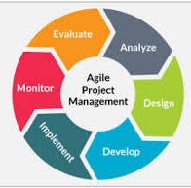
Agile Scrum Benefits
Higher productivity
Better-quality products
Reduced time to market
Improved stakeholder satisfaction
Better team dynamics
Happier employees
Notes:
The best part about Agile Scrum methodology is that where other project management methods emphasize building an entire product in one iteration from start to finish, the agile scrum methodology focuses on delivering several iterations of a product to provide stakeholders with the highest business value in the least amount of time. Other benefits include the allowance of products to be built faster, since each set of goals must be completed within each sprint's time frame. It also requires frequent planning and goal setting, which helps the scrum team focus on the current sprint's objectives and increase productivity.

Slide 6
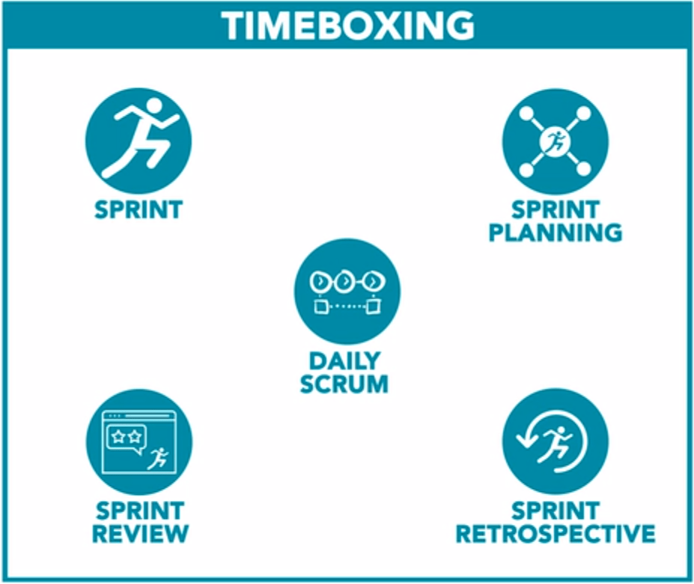
Agile Scrum Events
Sprint Planning
Sprint
The Daily Stand Up
The Sprint Review
The Retrospective
Notes:
The life cycle of an Agile Scrum event starts with sprint planning. It is where most of the legwork happens, allowing for foundations to be laid for how the next 2 weeks are going to go. The sprint encompasses the two weeks that we have to get all of our prescribed work done. The daily stand up is a meeting where everyone contributes to what they have completed, what they aim to focus on next, and the issues they have faced. The daily stand up is one of the most important part of the sprint, because it allows members to keep others up to date on their workings day-to-day rather than once every few days. While the sprint review and retrospective focus on how that sprint went and what issues could be fixed or optimised for the next sprint.

Slide 7
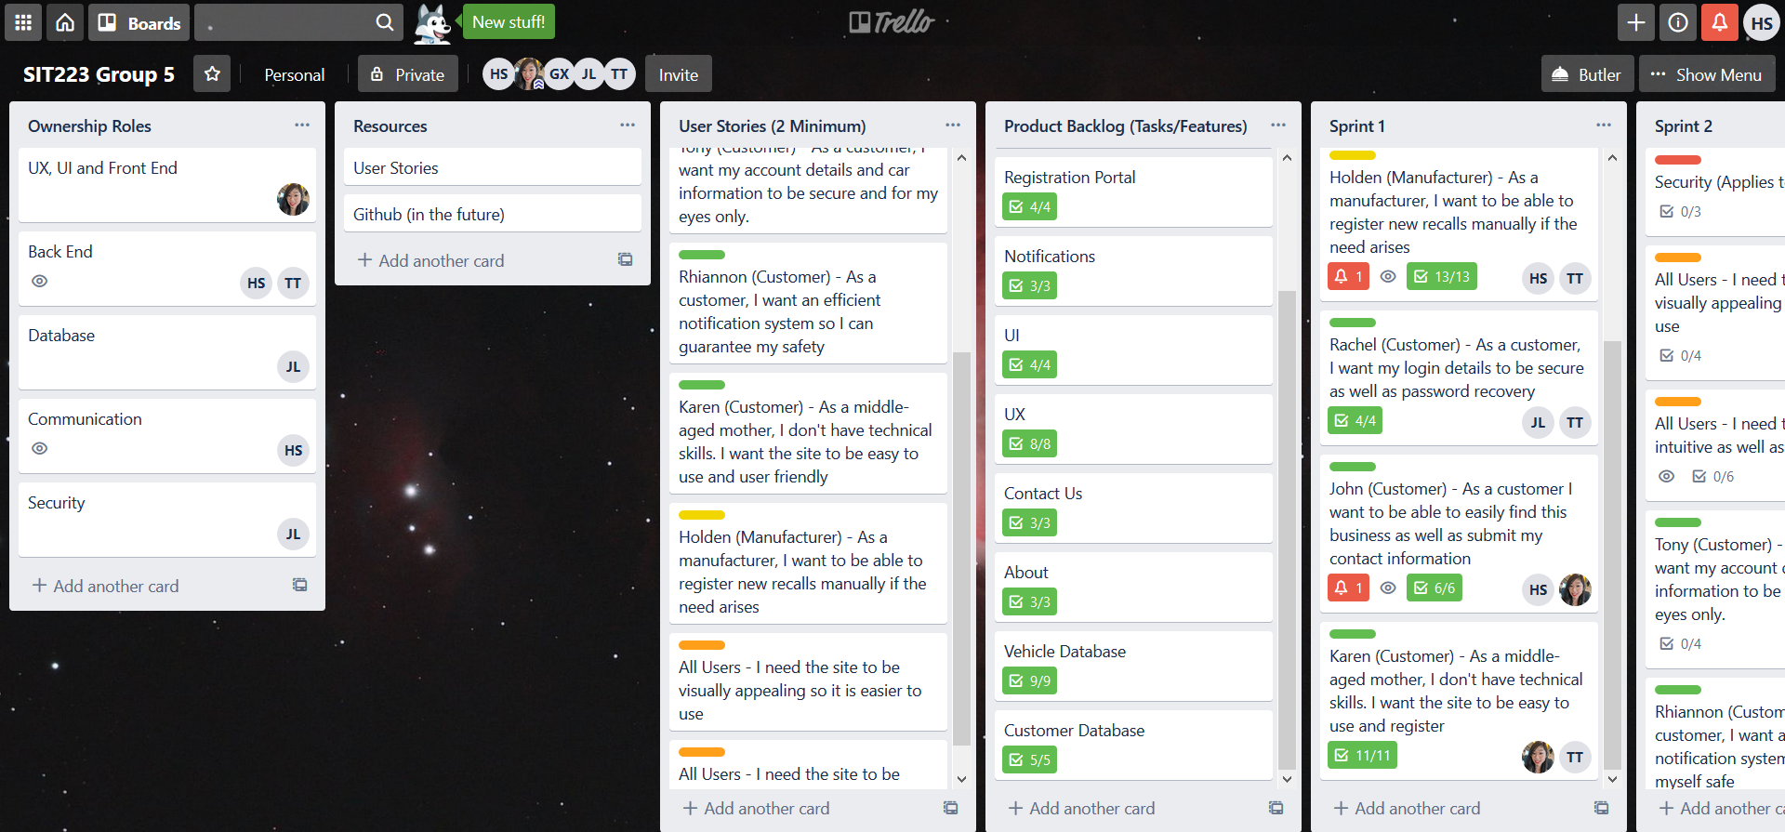
Our Trello Board
Notes:
So after building the team and understanding the project, it was now time to create a communication platform to assign tasks and exchange work and ideas. For this, we developed a Trello board . Trello is an effective tool massively used to manage tasks and team member task allocation that could be based on Agile environment. We set up our Trello boards and now it was time to fill it with content and assign the tasks. None of us had used Trello before so it took a little getting used to, but before long we were making it work very well.

Slide 8
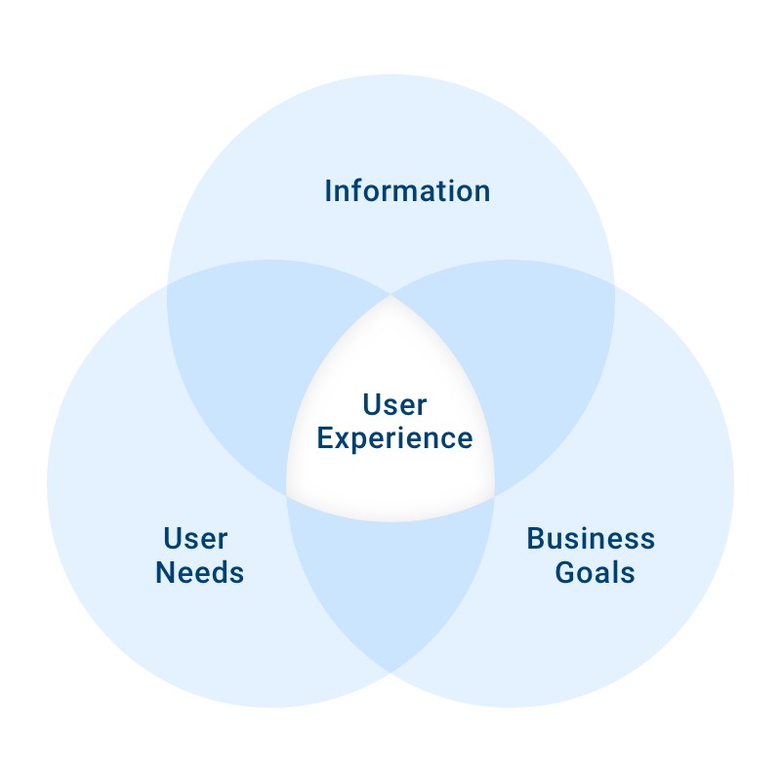
Project Logistics
Much more functionality than the 3 main features
Would need to be more in-depth as security is necessary
10 Features
>50 Sub Features
Figuring out what to split into each sprint was a challenge
Decided on leaving security, UI and UX for sprint 2 as we need to create a barebones functional project first
Notes:
From the project description, we extracted the tasks that have to be done to complete this project. Then as a group on MS teams chats, we discussed what the project description specifies, and built user stories. We decided that in order to create something that was both secure and functional, we would require a platform that has much more than just 3 main functionalities. So we decided on 10 main functionalities or pages and then created over 50 different sub-features from that. Before we could split the tasks into sprints we had to first comes up with the user stories and features. Figuring out what tasks to split into each sprint was an initial challenge but once we decided on leaving security, UX and UI for later, we decided on creating the barebones functionality first.

Slide 9
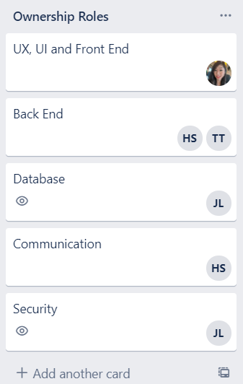
Sprint Planning (Ownership roles)
Some members have multiple roles
Backend is a colossal job, hence more members assigned
Everyone assigned themselves based on their specialities and expertise
Notes:
Before we could assign tasks to each team member we did group calls on MS teams to discuss what each member is comfortable and capable of. For instance Tushar has upper hand in web programming skills so we decided to give him BACK END. then Rina possesses exemplary knowledge of designing and editing tools like HTML, java, CSS so she was adequately prepared to handle FRONT END. Harshit has excellent communication skills and user Experience so he was assigned COMMUNICATION and BACK END. I am very well equipped with cybersecurity concepts and defences as well as knowledgeable in database systems and concepts, so I decided to take the SECURITY and DATABASES role.

Slide 10
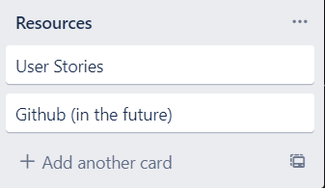
Sprint Planning (Resources)
User stories were main source of information
GitHub, to be implemented later when getting into more complicated areas of the project
Notes:
For our overall sprint planning we used resources like Trello Boards and plan to use GitHub in near future for some of our extended activities of the project. Github (or just Git as the service is called) is a version control platform that allows for efficient maintenance of code and allows for reflection through iterations if an issue arises. For the content and research work we used different websites like Atlassian.com and many more. YouTube videos and tutorials also played an instrumental role in developing our Trello board.

Slide 11
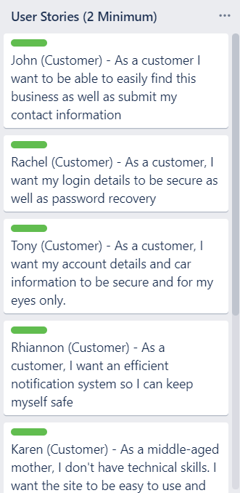
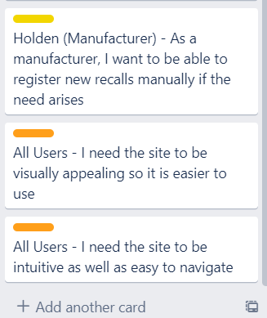
Sprint Planning (User Stories)
An integral part of the planning process
Created stories based on user needs
Used these stories in order to
choose which features to implement
Labelling system
Notes:
User stories are the primary artefact in Agile project management to capture user requirements. User stories provide a way to describe features of the system to be built from a user's (and customer's) point of view. A key component of the agile environment is putting people first, and user-stories put actual end-users at the center of the conversation. Stories use non-technical language to provide context for the development team and their efforts. After reading a user story, the team knows why they are building what they're building and what value it creates. They help provide a user-focused framework for daily work — which drives collaboration, creativity, and a better product overall. In order to avoid confusion and allow for some resemblance of aesthetics we implemented a simple labelling system for both user stories and tasks. Green would be customer, Yellow would be manufacturer, Orange would be all users, and Red would be miscellaneous but crucial.

Slide 12
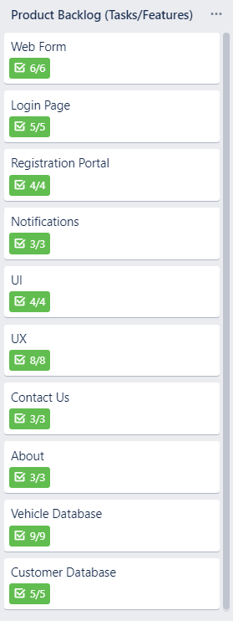
Sprint Planning (Features/Tasks)
10 Features
>50 Sub Features
Created them based on user stories
Were assigned to user stories later in the planning process
Used Checklists to correctly assign each feature to stories later
Notes:
After building the user stories, then comes the second most important component of the agile environment i.e. TASKS and FEATURES. we derived features that needed to be developed, and successively defined tasks that need to be done to develop those features. As a part of our sprint planning we listed all the tasks, created user stories and its features. One of the useful Trello functions was the implementation of checklists. We used checklists both for helping to create sub-features as well as helping to link the sub-features to the user story points later on.

Slide 13
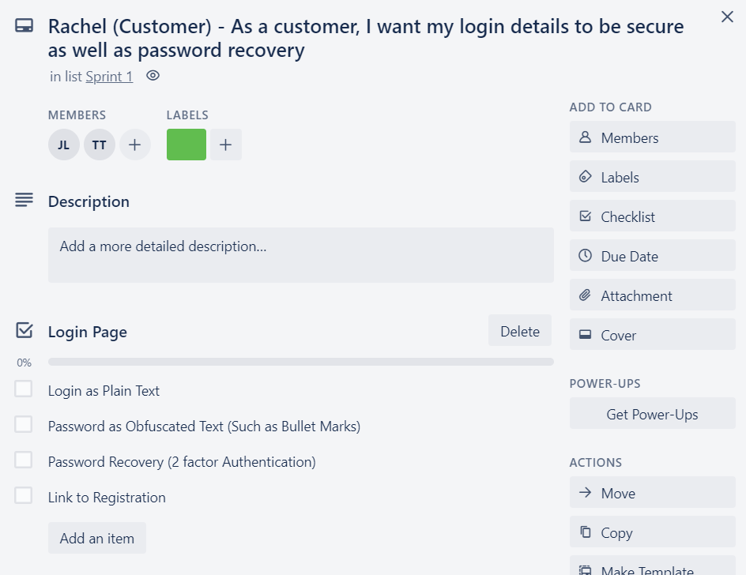
Sprint Planning (Story Points)
Assigning tasks/features to each user
story
Helps to organise and sort through
what needed to be done
Added checklists for each
feature/sub-feature
These story points were sorted into
sprints
Notes:
Story points were a great way to tie everything together and allowed our team members to see exactly what was important for which sprint and what features their tasks were contributing to directly. It helps to organise and keep track of tasks in an easier way, and the story points were what was used in our sprints. So for this example you can see that Rachel (a customer) would like for her login details to be secure as well as password recovery to be secure as well. So We included first the feature that relates to it, and then all of the sub-features that relate to the user story as well. Some user stories share some of the same features, but we tried to get the stories as diverse as possible.

Slide 14
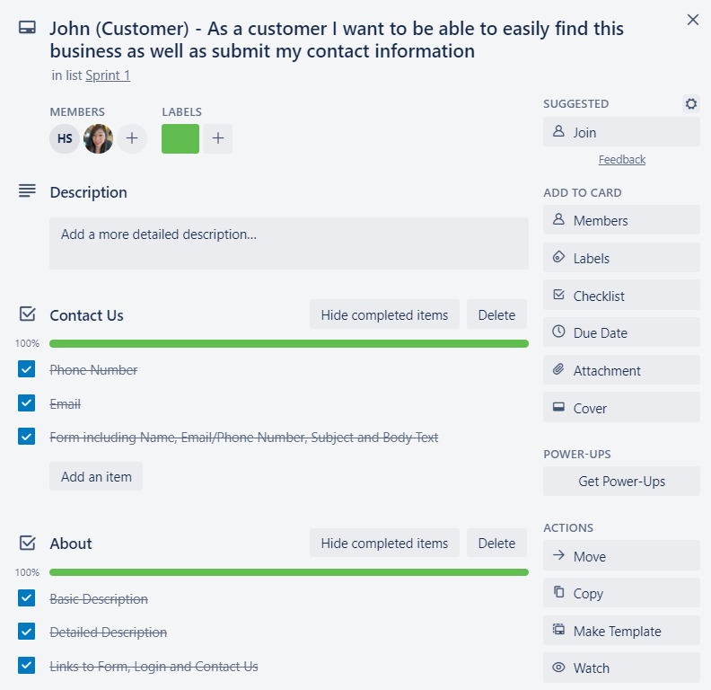
Sprint 1
Trusted each member to do
their part
Ticked off each feature as it
was implemented
Regular calls for updates
Got everything done in time for
sprint 2
Notes:
Some of the tasks we have included are like registration portal, notification, customer database, vehicle database, and many more. On our Trello board we have also broken down the whole situation into 2 sprints and divided the work for our team to operate efficiently. We trusted each team member to do their part and in our sprint we ticked off each feature as it was implemented. Not shown here is our technology stack which was conceptualised in sprint 1.

Slide 15
Retrospection
Issues Faced
COVID-19: Isolation and Transfer to Working from Home
Different sleep schedules
Availability differences day-to-day
Getting heads around agile management rather than traditional management
Notes:
Working with the team on a project like this was a great experience for everybody, but as a team we did struggle and had issues during our operation. Firstly due to COVID-19 it was difficult for us to adapt to this system of online learning and doing a group assignment made it even worse. Although MS teams is an effective communication tool it is difficult to communicate with everyone at the same time due to widespread differences in everyone’s daily availability. Moreover working in a scrum environment as compared to traditional methods was a bit challenging for our group as well.

Slide 16
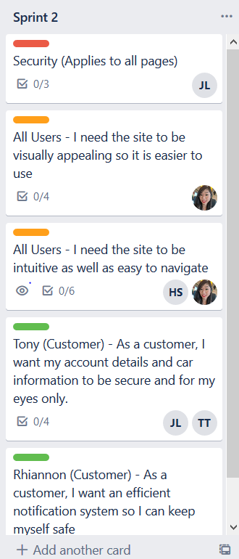
Sprint 2 Plan
Finer details
Security
UI
Github
Individual Responsibilities
Notes:
Going into sprint 2 with an idea of what we had the most trouble with will ultimately help in our planning and execution of the sprint. Firstly, while most of sprint 1 revolved around the idea of basic design and functionality on the website, sprint 2 will be focused more on the finer details, security, and UI of the site. As a result of this, we will need to set up a Github for the sprint as we get into more complicated iterations and versions of the codebase. In a team sense, we will need to be more responsible for our parts so that projects can be completed on time.

Slide 17
Bibliography (Harvard)
Atlassian, User Stories: Examples and Template. Available at: https://www.atlassian.com/agile/project-management/user-stories [Accessed May 7, 2020].
Collab Net, 2020. What Is Scrum Methodology? Available at: https://resources.collab.net/agile-101/what-is-scrum [Accessed May 7, 2020].

